Slide 1
Introduction to Investing
Prepared by Say Sabio

Slide 2
Outline
Why do we invest?
Risks in investing
What to do before investing?
Types of Investor
Investment Vehicles
FIRE Movement
Notes:
FIRE is an acronym for Financial Independence and Retire Early

Slide 3
Why invest?
Meet financial goals faster
Build wealth
Money habits
Compound earnings
Combat inflation
Opportunity cost

Slide 4
Risks in Investing
01
Risk of capital loss
02
Risk of not meeting expected returns

Slide 5
What to do before investing?
01
Build a financial plan
02
How much capital do you need?
03
Due diligence

Slide 6
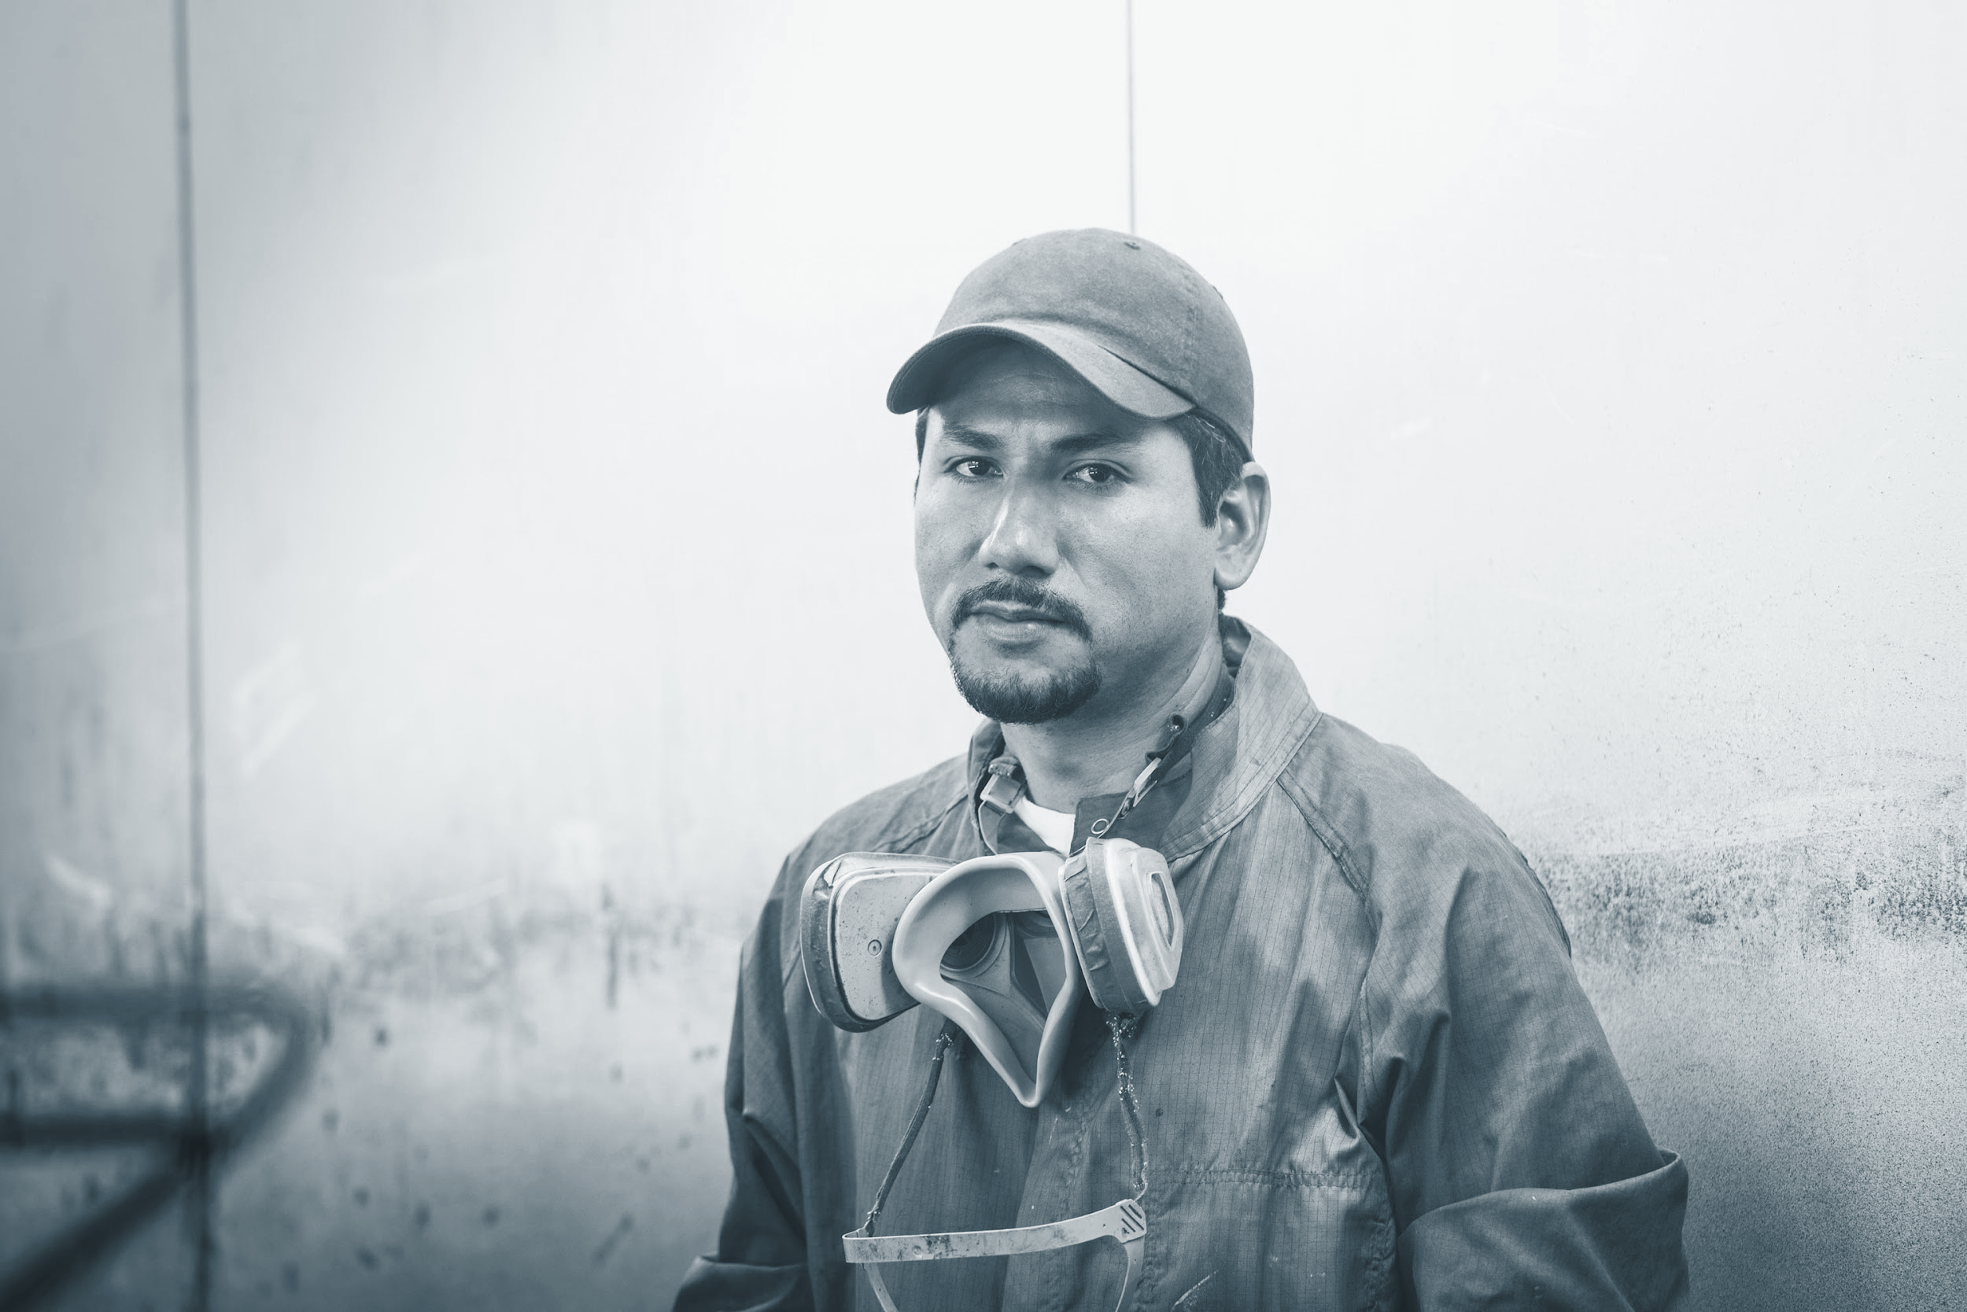


Types of Investor
Active Investor
Passive Investor
Retirement Investor

Slide 7
Investment Vehicles
Mutual Funds
Money Market Fund
UITF (Unit Investment Trust Fund)
Stock Market
PERA (Personal Equity and Retirement Account)
Pag-IBIG MP2
Notes:
A Unit Investment Trust Fund (UITF) is an open-ended pooled trust fund denominated in pesos or any acceptable currency, which is operated and administered by a trust entity and made available by participation.

Slide 8
FIRE Movement
(Financial Independence, Retire Early)
A lifestyle movement with the goal of becoming financially independent or retiring early or both.
You save and invest 50-70% of your income.
You work not because you need to but you want to.
Notes:
The general idea is that the higher your income is and the lower your expenses are, the faster you can reach financial independence. Think gazelle intensity—except the gazelle is literally on fire.

Slide 9
Thank you for listening!
For more questions, send me a message on FB, IG or Twitter

