Slide 1
Writing a job-winning Resume and Application Letter
By Mary Sabio

Slide 2
What is an Application Letter?
A letter that you write to a company when you are applying for a job.

Slide 3
Purpose of Application Letter
To secure an interview.
Eventually to land a job.

Slide 4
Parts of Application Letter
Heading
Inside Address
Salutation
Subject
Body of Letter
Complimentary Close
Signature

Slide 5
Heading
Contains the information of the sender, i.e., name, contact number, email address, address of the sender, and the date on which the letter is being written.
Example: Miguel Perez Contact Number: 09052678909 Email: miguelperez@fortunehs.com Address: Santan St., Fortune, Parang, Marikina City March 11, 2022
Notes:
Kelangan din nakalagay ang home address nyo para malaman ng hiring manager kung malayo ka ba sa office nila or malapit lang. Kelangan din kasi nila maconsider kung mag cocommute ka pag papasok sa office sakaling ma-hire ka nila.

Slide 6
Inside Address
Contains the name of the employer, his/her position, company’s name and the address of the company.
Example: Mr. Juan dela Cruz President, Diwata Company UP Technopark, Quezon City

Slide 7
Salutation
An expression of greeting to the employer that comes immediately before the body of the letter.
Example: Dear Mr. dela Cruz
NOTE: Make sure you write the correct spelling of the employer.

Slide 8
Subject
It specifies the topic of the letter. It comes between the salutation and the body of the letter.
Example: RE: Digital Marketing Associate
NOTE: Usually the subject is the name of the position you are applying for.

Slide 9
Body of the Letter
Part of the letter where you convey all the messages you want your reader to understand.
Ideally, it is nice to have at least three paragraphs and make your message straightforward. Avoid buzzwords and writing wordy paragraphs.
Notes:
Buzzwords are words na masyado ng mainstream or ‘gasgas’ na

Slide 10
Sample Body of the Letter
I would like to apply for the above position and believe my skills and experiences that match the requirements outlined in the job ad. I pride myself on being passionate and driven and have demonstrated this through my part time job experience last summer. As a self-starter and team player, I am sure I would be a strong addition to your company. Also, I hereby attached my resume for your reference. I would welcome the opportunity to discuss the role further and will follow this application up with a phone call in the next 2-3 days.
Notes:
Remind them bakit ikaw ang best candidate for the job

Slide 11
Complimentary Close
Serves to end the message or correspondence politely.
Example: Sincerely / Yours truly
NOTE: This phrase shows respect and appreciation for the person who is considering the request in your letter.
Notes:
Mga nababasa natin madalas sa letters like
Respectfully yours, cordially, etc.

Slide 12
Signature
Contains the name and signature of the sender /applicant.
Example: (Signature) Miguel Perez

Slide 13
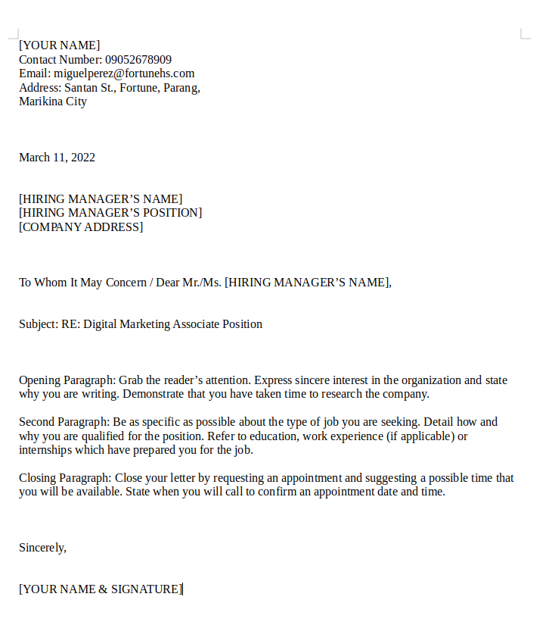
Sample Application Letter
Heading
Inside Address
Salutation
Subject
Body of the Letter
Complimentary Close
Signature

Slide 14
Application Letter Template
Download here: https://shorturl.at/grtMX

Slide 15
What is a Resume?
A summary of your experiences and skills relevant to the field of work you are entering.
Notes:
Quick advertisement of who you are

Slide 16
Purpose of Resume
Your marketing piece (You being the product)
Snapshot of what you have to offer
Highlight your soft skills and qualifications.
Notes:
Soft skills – personal attributes to effectively and harmoniously interact with others.

Slide 17
Effective Resume
Resume should be concise, brief and well-constructed.
Should not be more than 2-3 pages.
Notes:
Make a self-assessment and outline your skills and abilities on a piece of paper. This will help you make a thorough resume.

Slide 18
Parts of Resume
Heading
Job Objective
Skills
Work Experience
Educational Background
Achievements and Awards
Trainings / Seminars Attended
Personal Data
Character References
Notes:
Somewhat similar sa application letter

Slide 19
Heading
The first section of your resume that tells your name, contact number, email address that will help your potential employer to identify and contact you.
Example: Miguel Perez Contact Number: 09052678909 Email: miguelperez@fortunehs.com Address: Santan St., Fortune, Parang, Marikina City March 11, 2022

Slide 20
Job Objective
It summarizes the type of work you want to do and the career field in which you are interested.
Example: Job Objective: To obtain an entry-level position within a financial institution requiring strong analytical and organizational skills.
Notes:
It also tells potential employers the kind of work you want to do.

Slide 21
Skills
Summarize your academic skills, along with any related abilities and talents.
This will quickly show an employer a qualitative summary of the skills and experience you have to offer.

Slide 22
Work Experience
Briefly give the employer an overview of your work experiences that have taught you skills.
Use action words to describe your job duties.
Include your work experience in reverse chronological order (Latest work down to the first relevant job)
Notes:
Pwede nyo dito ilagay yung internship or OJT experience nyo. Or kung nagkaroon kayo ng summer jobs in the past.

Slide 23
Work Experience
Include the following:
Title of position
Name of company / organization
Location of work
Dates of employment
Describe your work duties and responsibilities

Slide 24
Educational Background
For most graduates, the most important qualification they have to offer is their education.
List the names and dates of degrees conferred in reverse chronological order

Slide 25
Achievements & Awards
You may also list all academic achievements such as being part of honor roll, etc.
Awards and other special recognitions.

Slide 26
Trainings / Seminars Attended
List all trainings and seminars you attended in the past that are relevant to the job you are applying for.
You could also include your certifications here.

Slide 27
Personal Data
Your personal information such as the following:
Full Name
Date of Birth
Place of Birth
Civil Status
Home Address
Religion

Slide 28
Character References
A recommendation provided by someone who knows you personally and can describe your attributes and traits.
List down at least 2 character references in your resume. Briefly indicate your relationship to them and provide their contact number (teacher, classmate, etc.)
Notes:
Sila yung mga nakakakilala sayo kung pano ka mag trabaho or mag isip para maka resolba ng problema. Also bago nyo ilagay information nila, magpaalam muna para hindi sila mabigla kapag may HR na tatawag para mag background check sa inyo. :)

Slide 29
Character References
Who to ask for a character reference:
Previous employer
Cowork
Co-volunteer or volunteer leader
Coach
Business acquaintance
Professor or academic advisor
Personal or professional mentor
Fellow student or graduate from an educational program
Neighbor or friend
Notes:
It’s best to avoid family members or relatives. Often references from them are not considered objective are unlikely to be taken as seriously as one from a teacher or a colleague.

Slide 30
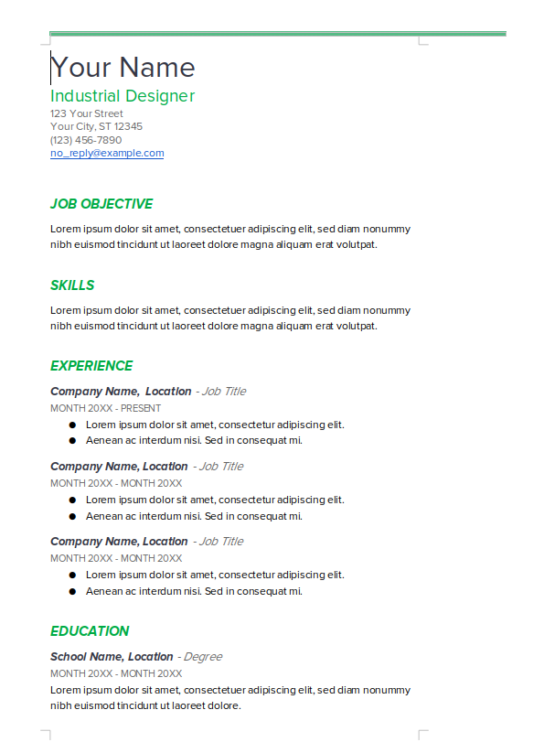

Slide 31
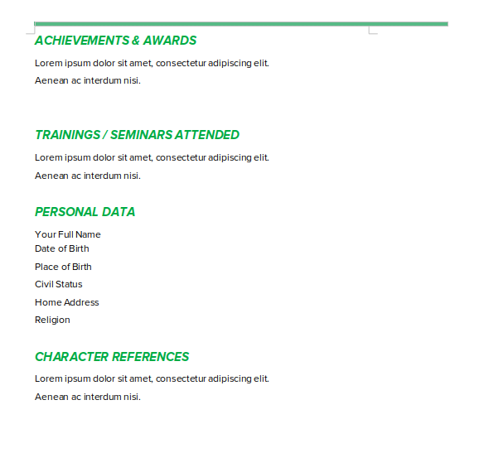

Slide 32
Resume Template
Download here: https://shorturl.at/hnEW3

Slide 33
Tips to craft your Application Letter and Resume
Use Grammarly (Free to download www.grammarly.com) To check grammar and spelling.
Do not put your photo if it is not required.
Proofread your application letter and resume before you submit to potential employers.
Be honest.
Notes:
Pwedeng teachers ang mag check or proofread para matulungan kayo

Slide 34
A well-structured resume does a number of things:
Paints a positive and factual picture of you.
Sets a positive tone for the interview.
Guides the interviewer in what to ask.
Influences others who approve the hiring.
Notes:
Pwedeng teachers ang mag check or proofread para matulungan kayo

Slide 35
Thanks for listening Fortune High School Senior High!

